Slide 1
UA/NASA Space Grant
2020 Statewide Symposium, Tucson, AZ
Crew Member Vital Signs
as Indicators of Environmental Changes aboard Space Habitats
Shaun Brown¹
Mentor: Wolfgang Fink¹, Ph.D., FAIMBE, FPHM, FSPIE
¹Visual and Autonomous Exploration Systems Research Laboratory,
College of Engineering, University of Arizona, Tucson, AZ, USA

Slide 2
Acknowledgements & Disclosures
Research support:
Shaun Brown has been supported by NASA traineeship grant NNH18ZHA007C via the Arizona Space Grant Consortium
NASA SBIR Phase II grant 80NSSC1900130
Edward & Maria Keonjian Endowment at the College of Engineering, University of Arizona
This presentation is part of a paper given at the IEEE Aerospace Conference on March 12, 2020:
Brown S, Prasad A, Fink W (2020) Inventory of Vital Sign Changes as Indicators of Environmental Changes aboard Space Habitats; IEEE Aerospace Conference Proceedings, paper #2794, Big Sky, MT

Slide 3
Outline
Motivation
NASA Relevance
NASA’s Space Technology Grand Challenges addressed
Motivation of ‘Crew as a Sensor’ Paradigm to monitor Space Habitat Health
Sensing Framework
Environmental Change Indicator Modality:
  ECG
  Blood Oxygenation (SpO₂)
  Ocular Structure and Visual Performance
Study Results
Conclusions & Next Steps

Slide 4
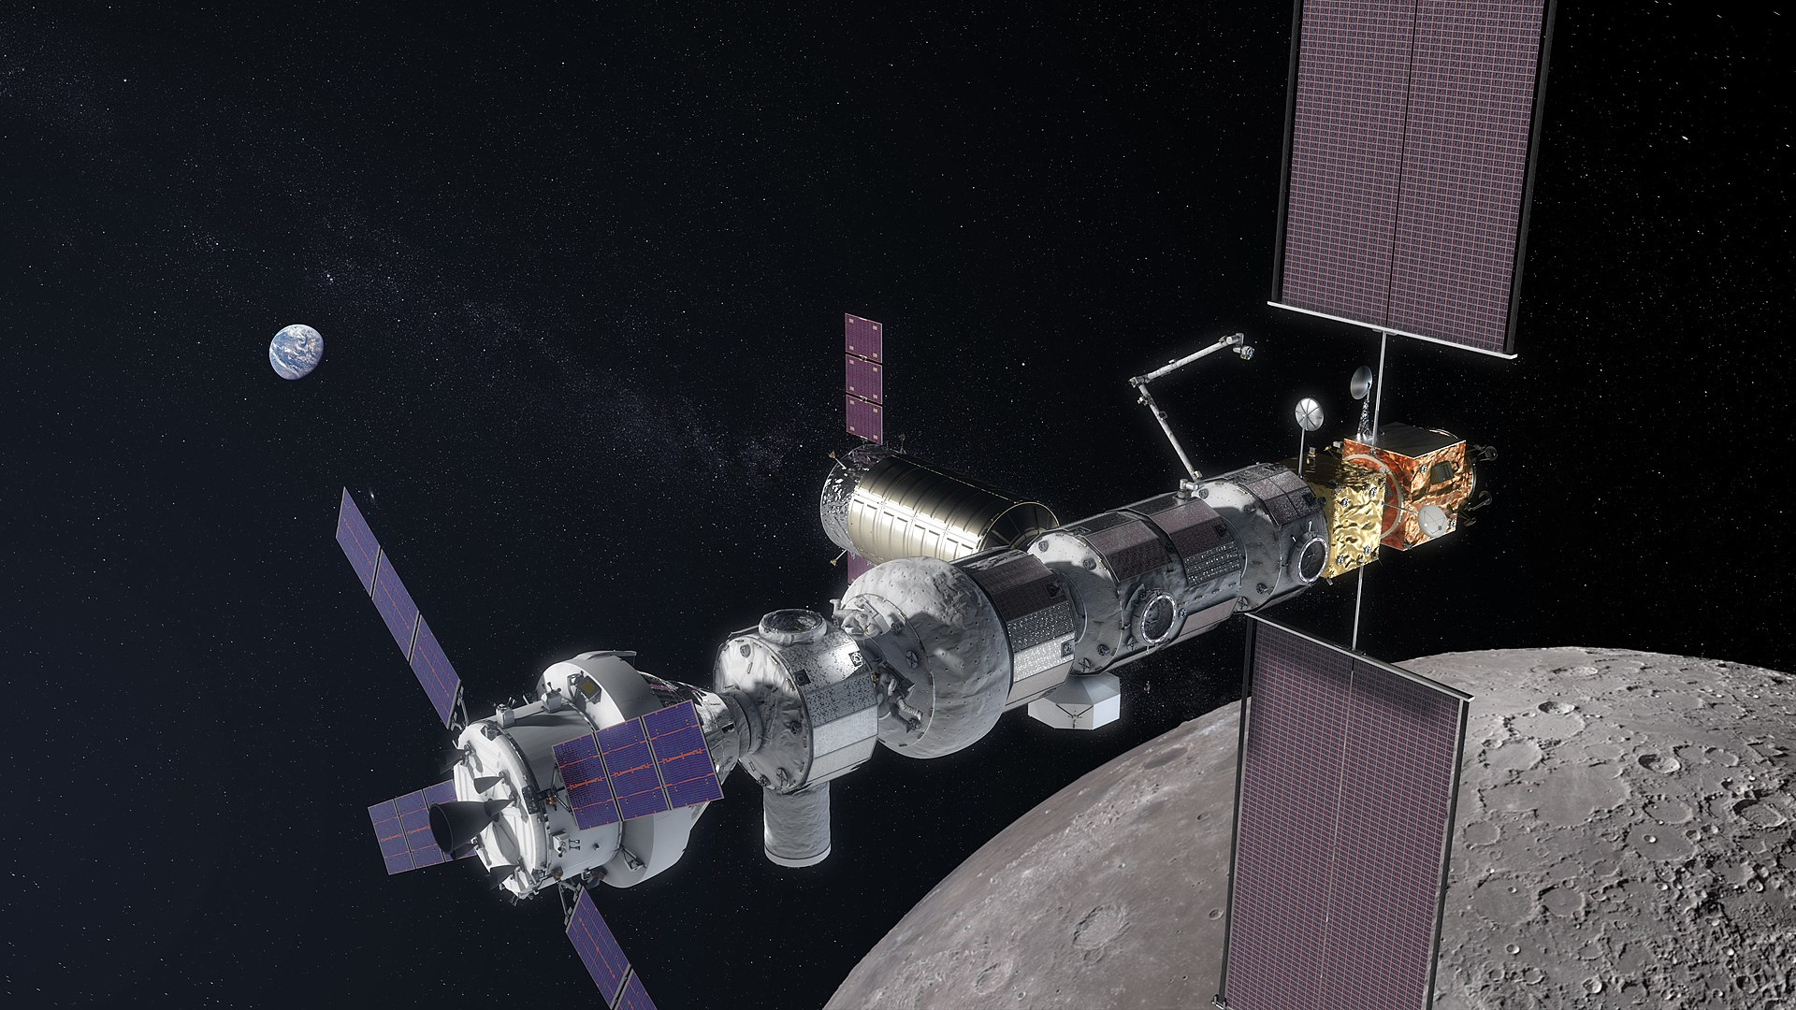
Motivation
NASA’s goal: Lunar Gateway orbiting the Moon
Expansion of human presence into low-Earth orbit
Autonomous operation of space habitats
Supplemental data to support those systems
Ensure a breathable atmosphere aboard space habitats

Slide 5
NASA Relevance
NASA’s Lunar Orbital Platform Gateway
Important to ensure low-payload and self-reliance of crew-members (see also healthcare autonomy paradigm vs. tele-medicine paradigm (Popov et al., IJPHM 2019))
Autonomous operation of life support systems
Autonomous regulation of atmosphere aboard space habitats
NASA Space Technology Grand Challenges:
  Space Health and Medicine
  Space Colonization

Slide 6
NASA’s Space Technology Grand Challenges:
Space Health and Medicine
Grand Challenge:
“Eliminate or mitigate the negative effects of the space environments on human physical and behavioral health, optimize human performance in space and expand the scope of space based medical care to match terrestrial care.”
Stated Problem:
“Space is an extreme environment that is not conducive to human life. Today’s technology can only partially mitigate the effects on the physical and psychological well-being of people. In order to live and effectively work in space for an extended period of time, people require technologies that enable survival in extreme environments; countermeasures that mitigate the negative effects of space; accommodations that optimize human performance; comprehensive space-based physiological and physical health management and prompt and comprehensive medical care in a limited infrastructure.”
http://www.nasa.gov/pdf/503466main_space_tech_grand_challenges_12_02_10.pdf

Slide 7
NASA’s Space Technology Grand Challenges:
Space Colonization
Grand Challenge:
“Create self-sustaining and reliable human environments and habitats that enable the permanent colonization of space and other planetary surfaces.”
Stated Problem:
“Currently, the infrastructure and integrated technologies needed to enable permanent, self-sufficient human settlements away from Earth do not exist. Effective close-loop systems do not exist to replenish consumable resources. This makes long-term stays cost-prohibitive and poses significant risk to personnel if resupply missions do not arrive on time.”
http://www.nasa.gov/pdf/503466main_space_tech_grand_challenges_12_02_10.pdf

Slide 8
Motivation of ‘Crew as a Sensor’ Paradigm
To Monitor Space Habitat Health
Paradigm originally formulated by Andrew Hess (President PHM Society), 2019
Underlying Principle: Canary in a Coal Mine
Organisms (i.e., crew members) function as versatile biosensors
Paradigm provides greater context and more data to onboard autonomous monitoring systems
Autonomic vital sign changes, due to space habitat environmental changes, being transduced in both qualifiable and potentially quantifiable modalities:
  ECG
  Blood oxygenation (SpO₂)
  Ocular structure changes
  Visual performance assessment

Slide 9
Sensing Framework
Fabricated/artificial sensors
  Individual pressure transducers (e.g., recording habitat leaks), photodiodes (e.g., recording lack of habitat light shielding), O₂/CO₂/CO-detectors (e.g., recording of outgassing events), thermosensors (e.g., recording of thermal shielding failure), etc.
Combinations of sensors
Multi-modal interpretation of sensor data (potential use case for Machine Learning, Deep Learning, Artificial Intelligence, etc.)
Abiotic sensors combined with human biosensors

Slide 10
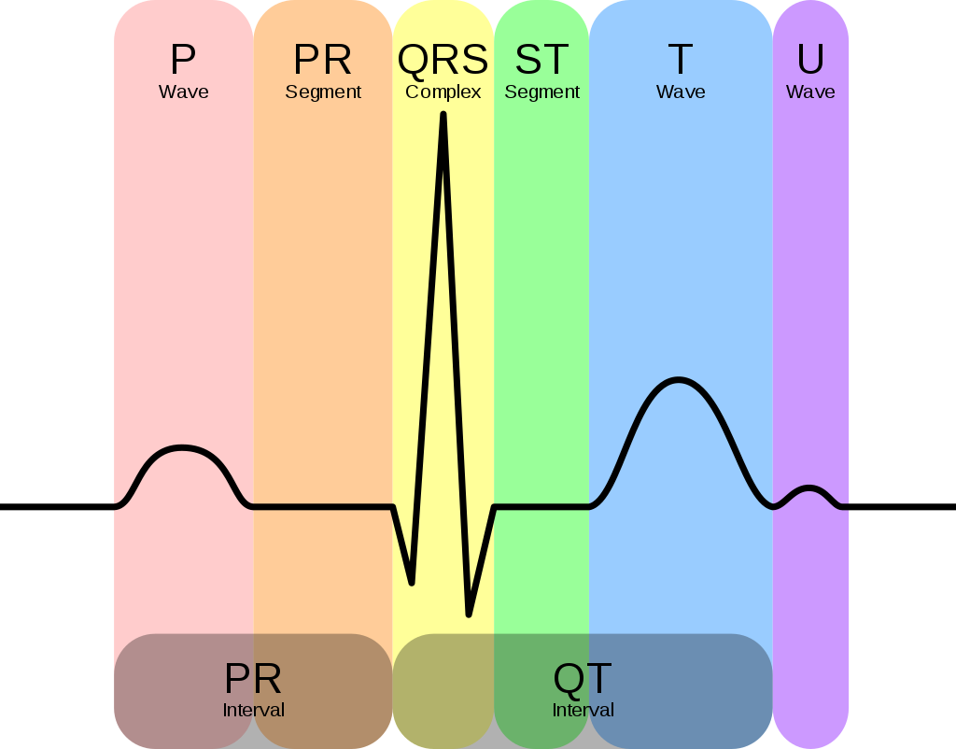
Environmental Change Indicator Modality:
ECG
Features of a standard ECG wave
Measurable ECG changes in response to O_{2,} CO₂, CO, and radiation
Looking at effects in the morphology of ECG readings

Slide 11
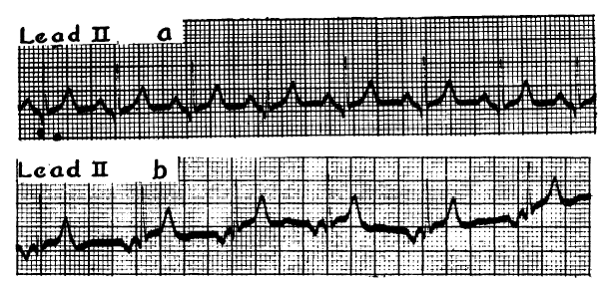


Environmental Change Indicator Modality:
ECG: Examples of Morphology Changes
Top: ECG recording before radiation therapy in a 48-year-old woman. Bottom: After 6 months postoperative radiation therapy, showcasing T-wave changes.
Top: ECG readings before CO₂ administration. Bottom: ECG readings after CO₂ administration with P-wave inversion.

Slide 12
Environmental Change Indicator Modality:
ECG: Morphology Shifts in Response to Adverse Events
Adverse Event | Environmental change | Qualitative Symptoms | Morphology response, i.e., crew member vital sign change
Fire in microgravity environment | CO increase, formaldehyde production [52] | Headache, nausea, loss of consciousness | ST-segment elevation/depression; T-wave inversion
Leak in habitat | Pressure drop, O₂ decrease [53] | Shortness of breath, dizziness, visual disorders, rapid heartbeat | RS-T segment elevation, T-wave inversion
Outgassing from habitat components [54] | CO₂ increase, presence of volatile compounds | Shortness of breath, dizziness, fatigue, loss of consciousness | Lowering and inversion of P-waves, T-wave inversion

Slide 13
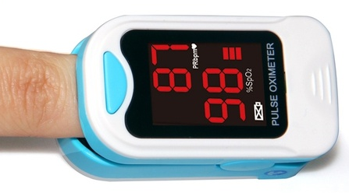
Environmental Change Indicator Modality:
Blood Oxygenation (SpO₂)
Commercial-off-the-shelf (COTS) pulse oximeter
Pulse oximeters to measure arterial oxygen saturation (SpO₂)
Functions to observe abnormalities in O₂ and CO₂ saturations (e.g., O₂-leaks or CO₂ outgassing)
Cannot distinguish between O₂ and CO (e.g., may not detect CO-outgassing event aboard a space habitat)

Slide 14
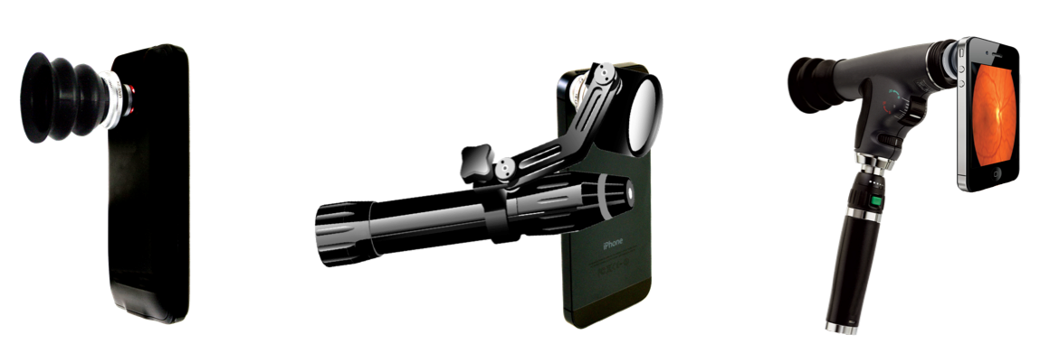
Environmental Change Indicator Modality:
Ocular Structure and Visual Performance
Example smartphone-based ophthalmic examination devices, from left to right: microscope, slit lamp, and fundoscope/ophthalmoscope (Fink et al., SPIE 2016)
Smartphone-based ophthalmic examination devices (Fink et al., SPIE 2016)
Spaceflight-Associated Neuro-ocular Syndrome (SANS)
  Caused by microgravity
  Manifested as decreased near-field visual acuity
Vascular and ocular structure remodeling
  Caused by elevated CO₂
  Changes manifest over time (i.e., not immediate)
  Recording of subtle drifts/shifts in environmental parameters

Slide 15
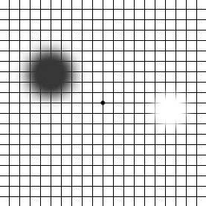
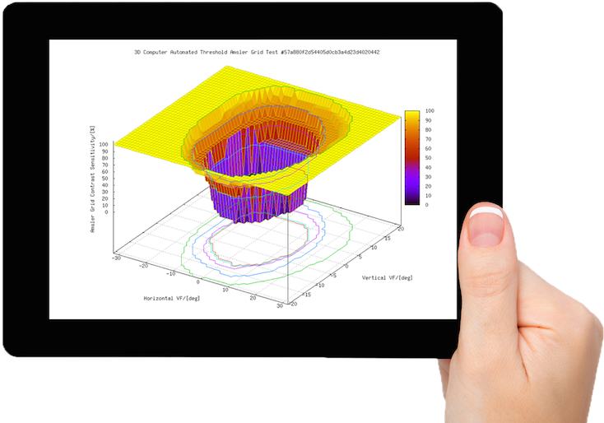

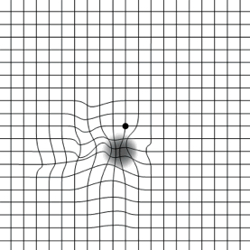
Visual Performance Assessment System (Adams, Cerwin, Fink, SPIE 2016)
Environmental Change Indicator Modality:
Ocular Structure and Visual Performance (cont.)
CVFATM Visual performance test result: central hill-of-vision.
Tablet configuration of visual performance assessment system.
Manifestation of scotomas (i.e., visual field defects, exhibited by missing grid lines) on an Amsler grid.
Potentially record visual field/visual performance defects due to radiation

Slide 16
Study Results
Sensitivity, Specificity, and Time to Criticality of Modalities
Environmental Change Indicator Modality | Sensitivity | Specificity | Time to Criticality
ECG | Autonomic nervous system responds to all stimuli – ECG captures autonomic nervous system changes, e.g., measures the heart | Imprecise – Individuals autonomically respond to stimuli differently and with varying degrees | During exposure; point measurements
Blood Oxygenation | Accuracy of ± 2% in measuring blood oxygen saturation | Cannot discern between O₂ and CO in blood saturation readings | During exposure; point measurements
Ocular Structure and Visual Performance | No immediate changes as a result of specific atmospheric stimulus | Microgravity is primary causative factor; CO₂ is a secondary factor | Long term; subtle changes over time

Slide 17
Conclusions & Next Steps
Direct ECG response non-specific to environmental changes
SpO₂ good for O₂, but not in the presence of CO
Ocular structure changes and visual performance may record only subtle drifts/shifts in environmental parameters over longer periods of time, hence not useable during exposure
Need to establish ECG motifs that are representative of environmental parameter changes
Subsequent anomaly detection (i.e., utilizing machine learning, deep learning, artificial intelligence)

Slide 18
Questions?
Thank you!
For more information:
Prof. Wolfgang Fink, Ph.D.
Visual and Autonomous Exploration Systems
Research Laboratory
Depts. of Electrical & Computer Engineering, Biomedical Engineering,
Systems & Industrial Engineering, and Ophthalmology & Vision Science
University of Arizona
wfink@email.arizona.edu
http://autonomy.arizona.edu

